Slide 1
Introduction to Object-Oriented Programming: Java

Slide 2
Chapter 5
Classes and Methods

Slide 3
00
Vocabulary, Concepts, and Skills

Slide 4
VOCABULARY
Classes | Calling or Invoking a Method
Methods | Reusability
Modules | Information Hiding
Instance Variables | Accessor Methods
Attributes | Mutator Methods
Declaring a Method | Access
The Signature of a method | Encapsulation
The Body of a Method | Reference Types
The return Statement | OOP (Object-Oriented Programming)

Slide 5
CONCEPTS
Classes
Modules
Void, non-void methods
Parameters, Arguments
Single Method Return
What a Method Does vs. How It Does It

Slide 6
SKILLS
Creating Classes
Creating Methods
Using UML for Documentation

Slide 7
Chapter 5
The Details

Slide 8
12
Using Only One Single Return

Slide 9
Multiple return Statements
No method should have more than one return statement
  Multiple return statements should be avoided
if (x > 0)
return x;
else
return 0;

Slide 10
Using a Single return Statement
Here is a better way to code that
Change this to
int answer = 0;
if (x > 0)
answer = x;
return answer;

Slide 11
13
Methods That Do Tasks

Slide 12
Methods that Do Tasks
This is the second kind of method
  This kind of method only does a task
It does not return an answer
If you are asked to sweep the floor, do you come back and say 34.6?
If you are asked to do the dishes, do you say 0.3487?

Slide 13
14
Void Methods

Slide 14
Using the Type void
void is a type
It’s a way of saying “No type”
Methods can be of type void
They don’t have return statements because they don’t have to return an answer

Slide 15
15
Void Methods—An Example

Slide 16
An Example of a void Method
We want to print a dollar and cent amount
We would like to use a method
Let’s call the method printCurrency
Notice that the method only prints
It doesn’t need to return an answer

Slide 17
The Method
public void printCurrency (double amount)
{
System.out.printf (“$%.2f\n”, amount);
}
Notice the lack of a return statement

Slide 18
A Method That Calls Our Method
public class MethodExample
{
public static void main (String [] args)
{
double cost = 17.35;
printCurrency (cost);
}
}

Slide 19
How This Works
The JVM will get to the line
  printCurrency (value);
First, it will copy the value of the variable “cost” to the variable “amount”
Then, it will execute the instructions in the printCurrency method
This will cause it to print $17.35

Slide 20
Another Example of Calling a Method
public class MethodExample
{
public static void main (String [] args)
{
printCurrency (10.15);
printCurrency (7.09);
printCurrency (1398.10);
}
}

Slide 21
Running this Example
When we run this program, it will print
  $10.15
  $7.09
  $1398.10
We can use the method over and over to print dollar amounts

Slide 22
16
More Vocabulary

Slide 23
Vocabulary for Using a Method
We say
  main() called printCurrency
  main() invoked printCurrency

Slide 24
17
Summary:
Creating Methods

Slide 25
Steps for Creating a Method
Decide specifically what the method has to do
Decide what must be returned
  Void vs. Non-void method
Decide on the arguments
Give the method a name

Slide 26
18
Methods Are Very Valuable

Slide 27
The Value of Methods
Here we see one advantage of a method
  The method can be called over and over
We don’t have to rewrite all those printf statements every time
We just “reuse” the method
We say a method is reusable

Slide 28
The Benefits of Using Modules
Every computer language has some kind of module
  For us modules means methods
See the PowerPoint about Modular Programming

Slide 29
19
Unit Testing

Slide 30
Unit Testing-A Modular Idea
The chapter also talks about unit testing
Unit testing is an idea based on the modular approach
It says that to test a program you just test the modules (units) that make it up

Slide 31
20
Illustrating a Class--UML

Slide 32
Unified Modeling Language (UML)
UML uses a three-box picture to describe a class
  Top box: Name of the class
  Middle box: Variables with information in “backwards order”
    This is Name: type
  Bottom box: Methods (also in backwards order)

Slide 33
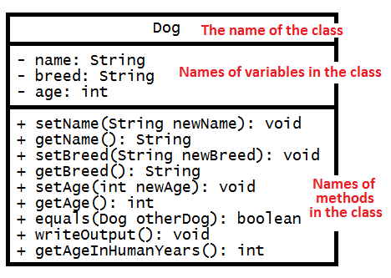
UML for the Dog Class

Slide 34
Explanation of that UML
The top box is the name of the class
The middle box is a list of variables
  Notice this is in “reverse” order
  The format is name, then a colon, then the type
The bottom box is a list of the methods
  Each method has a signature and type
  Again, the order is reversed

Slide 35
Those +, - Signs
There are + and – signs in front of variables and methods
  + means the item is public
  - means the item is private

Slide 36
Information Hiding
This is a key idea of object-oriented programming
This prevents data from being changed
  This can be, and often is, accidental
  This can also be with malicious intent

Slide 37
THANKS!

